Slide 1





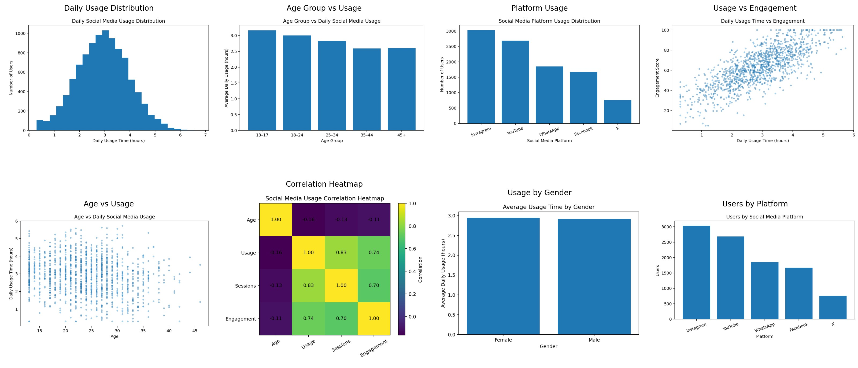

Data Cleaning and Visualization of Social Media Usage Patterns
Name : B. Purna Kishor Reddy | Reg. No : 192472171 || Course Name : Fundamentals of Data Science || Course Code : DSA0405
1. INTRODUCTION
2. DATASET
PROBLEM
Identify social media usage patterns.
Analyze time spent on different social media platforms.
Understand user engagement and activity.
APPROACH
Collect social media usage data.
Clean and organize the dataset.
Perform descriptive and exploratory analysis.
Visualize usage patterns.
Interpret the findings.
WHY THIS STUDY?
Understand user behaviour.
Identify highly used platforms.
Study relationships between usage variables.
Support better understanding of digital habits.
SOURCE:
Social Media Usage Dataset
TOTAL RESPONSES:
10,000 Customers
KEY VARIABLES COLLECTED
DATA
10,000 Users
14 Variables
Numerical & Categorical Data
Usage and engagement information
Demographic information
User ID
Age
Gender
Social Media Platform
Daily Usage Time
Number of Sessions
Posts Per Day
Comments Per Day
Shares Per Day
Most Used Platform
Engagement Level
Sleep Duration
Usage Frequency
Likes Per Day
3. METHOD PIPELINE
4. RESULTS
DATA COLLECTION
DATA CLEANING
DESCRIPTIVE STATISTICS
EXPLORATORY DATA ANALYSIS
VISUALIZATION
INTERPRETATION
5. CONCLUSION
6. FUTURE DIRECTIONS
KEY INSIGHT
Data cleaning improves the quality and reliability of social media data.
Visualization makes usage patterns easier to understand.
Different platforms show different levels of user engagement.
Usage time and engagement can reveal meaningful behavioural patterns.
Real-Time Monitoring: Develop real-time dashboards to track social media usage patterns . Analyze usage trends over time.
Apply machine learning to predict user behaviour.
Study the relationship between social media usage and productivity.
10,000 Users | 14 Variables
Data cleaning improves the accuracy of social media analysis.
Daily usage time identifies user activity patterns.
Popular platforms show higher user engagement.
Visualization makes usage trends easier to understand.

